Slide 1
Machine Learning INET Fall 2024

Slide 2
Agenda
Convolution operation
Convolutional Neural Networks
VGG
ResNet
Notes:
What is an Image?
An image is a visual representation made up of a finite set of locations called pixels.
Each pixel is the smallest unit of an image and contains color information.
Together, the pixels create the entire picture seen in an image.
Pixels: The Building Blocks
Pixels are the individual building blocks that make up a digital image.
A pixel represents the smallest unit of an image and encodes color information.
The color of a pixel may be represented by RGB (red, green, blue) values or a grayscale intensity.
An image contains rows and columns of pixels, forming a 2D grid of points.
The number of pixels determines the resolution. Higher resolution means more, smaller pixels.
Changing pixel colors allows modifying parts of the image.
Pixels come together through the 2D grid structure to represent the entire visual information in an image.

Slide 3
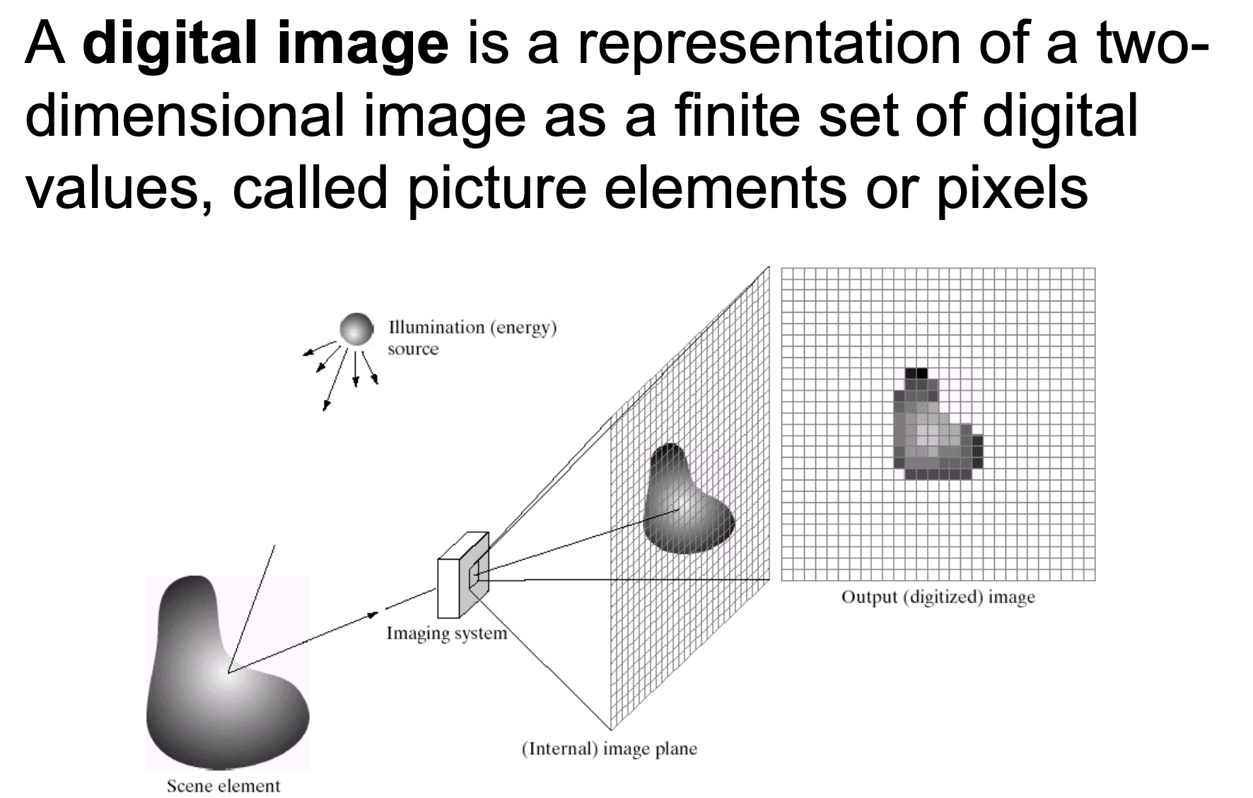
Digital Images
What is an Image?
An image is a collection of finite locations or points.
Each location is called a "pixel."
Each pixel contains a color value.
Pixels: The Building Blocks
Pixels are the smallest units in an image.
Notes:
What is an Image?
An image is a visual representation made up of a finite set of locations called pixels.
Each pixel is the smallest unit of an image and contains color information.
Together, the pixels create the entire picture seen in an image.
Pixels: The Building Blocks
Pixels are the individual building blocks that make up a digital image.
A pixel represents the smallest unit of an image and encodes color information.
The color of a pixel may be represented by RGB (red, green, blue) values or a grayscale intensity.
An image contains rows and columns of pixels, forming a 2D grid of points.
The number of pixels determines the resolution. Higher resolution means more, smaller pixels.
Changing pixel colors allows modifying parts of the image.
Pixels come together through the 2D grid structure to represent the entire visual information in an image.

Slide 4
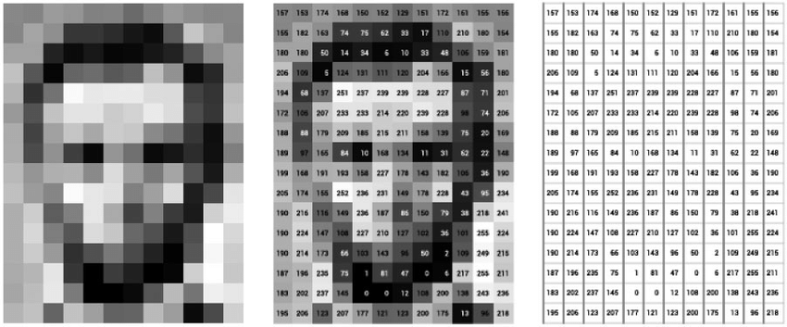
Digital Images
Image Source:
https://www.researchgate.net/publication/330902210_The_visual_digital_turn_Using_neural_networks_to_study_historical_images

Slide 5
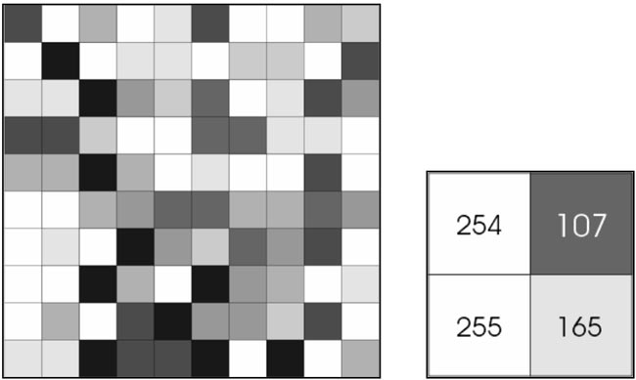
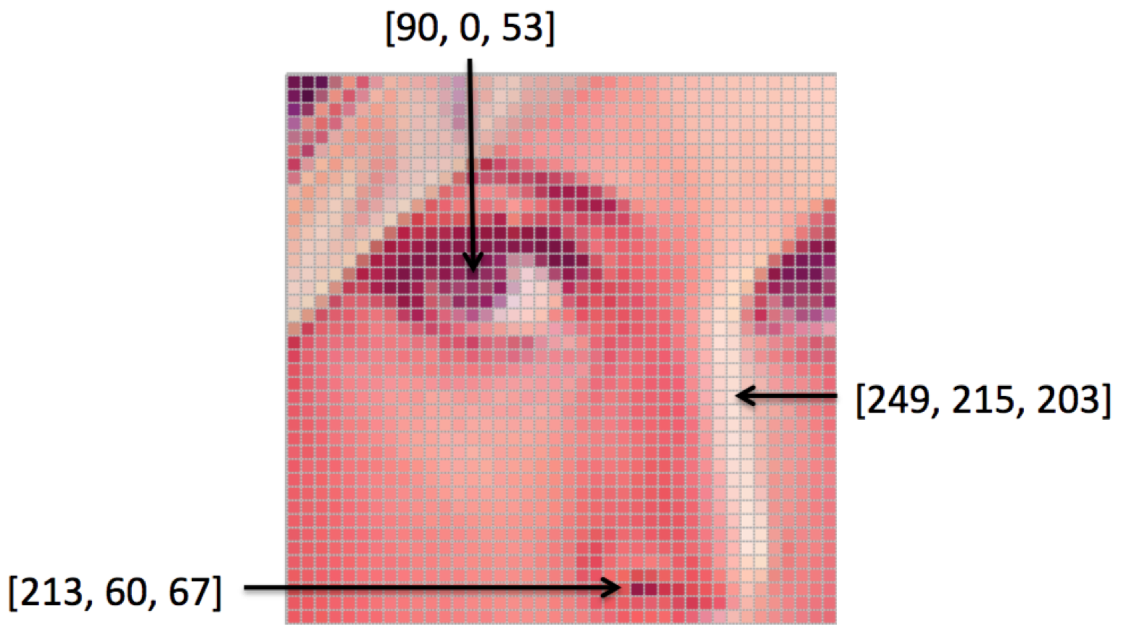
Digital Images
Grayscale Images
They use shades of gray to represent colors.
Each pixel in a grayscale image has a single value, typically ranging from 0 (black) to 255 (white).
Color Images
Uses a combination of colors to represent the full spectrum.
Each pixel in a color image typically has three values: Red, Green, and Blue (RGB).
Image Source: https://ai.stanford.edu/~syyeung/cvweb/tutorial1.html
https://victoriaprice135050.wordpress.com/2015/04/28/investigate-into-pixels-picture-element-and-image-resolution-intensity/

Slide 6
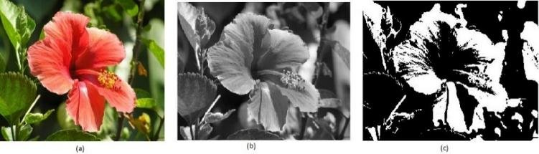
RGB vs Grayscale vs Binary Image
Color Image: An RGB (Red, Green, Blue) image is a type of digital image that represents colors by combining three color channels, each corresponding to one of the primary colors. (Fig a)
Grayscale Image: A grayscale image is a single-channel image that represents variations in intensity using shades of gray. (Fig b)
Binary Image: A binary image is a type of digital image that contains only two pixel values, typically representing objects as black and the background as white (or vice versa). (Fig c)
Image Source: https://www.researchgate.net/figure/Figure2-a-RGB-image-b-Gray-Scale-image-c-Binary-image_fig2_344249310

Slide 7
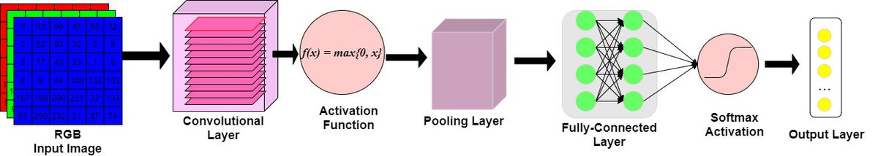
Big Picture: Convolutional Neural Networks
CNNs consist of :
convolutional layers for feature extraction
Pooling layers for down-sampling
Fully connected layers at the end for classification

Slide 8
Convolution Operation

Slide 9
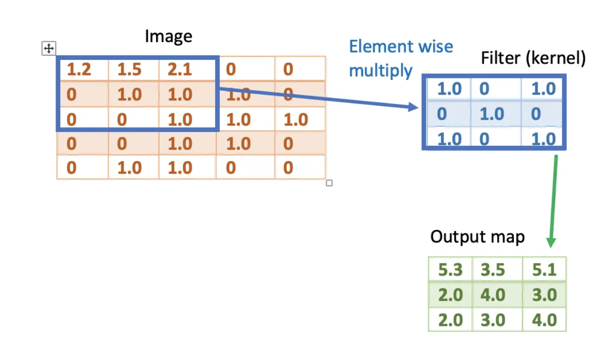
Understanding Convolutions
Convolution is the mathematical operation between a kernel (filter) and an input feature map.
The kernel is usually a small matrix e.g. 3*3 or 5*5
The input is always a feature map with height, width, and channels.
Notes:
Convolutions play a crucial role in image manipulation, allowing us to enhance and transform images in various ways.
They involve applying filters or kernels to images, altering the pixel values and extracting meaningful features.
Talk about what are Convolutions to give the students a refresher?
Convolutions are mathematical operations performed on images using small matrices called filters or kernels.
Each filter consists of weights that determine how neighboring pixels contribute to the output.

Slide 10
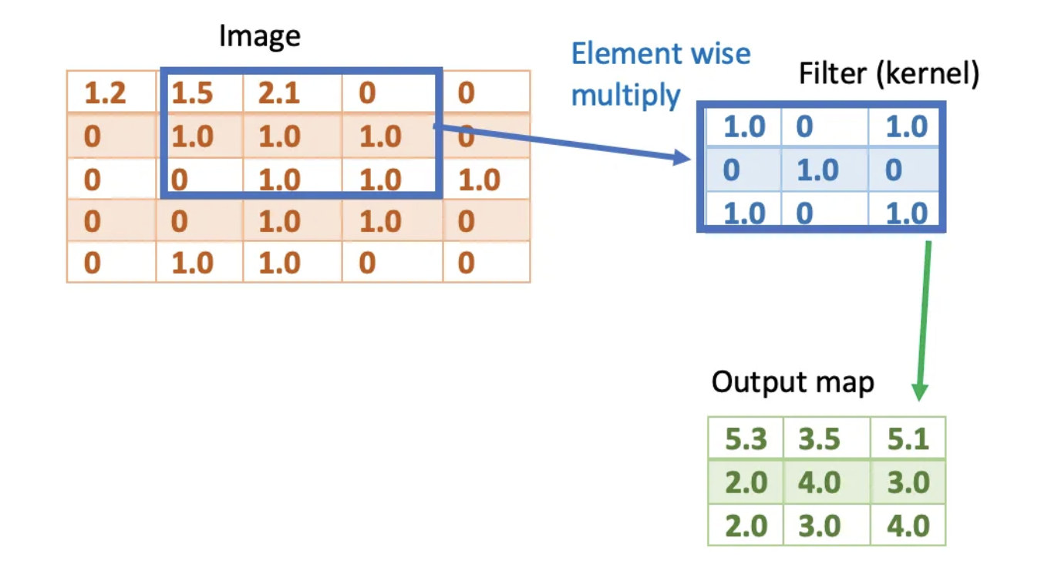
Understanding Convolutions
Notes:
Convolutions play a crucial role in image manipulation, allowing us to enhance and transform images in various ways.
They involve applying filters or kernels to images, altering the pixel values and extracting meaningful features.
Talk about what are Convolutions to give the students a refresher?
Convolutions are mathematical operations performed on images using small matrices called filters or kernels.
Each filter consists of weights that determine how neighboring pixels contribute to the output.

Slide 11
How do convolutions work?
Slide filter over image
Compute weighted sum
Weights x Pixel values
Sum for output value
Notes:
The convolution operation involves sliding the filter over the image, computing a weighted sum of the pixel values at each position.
The filter's weights are multiplied with the corresponding pixel values, and the resulting values are summed to obtain the output value at that position.

Slide 12
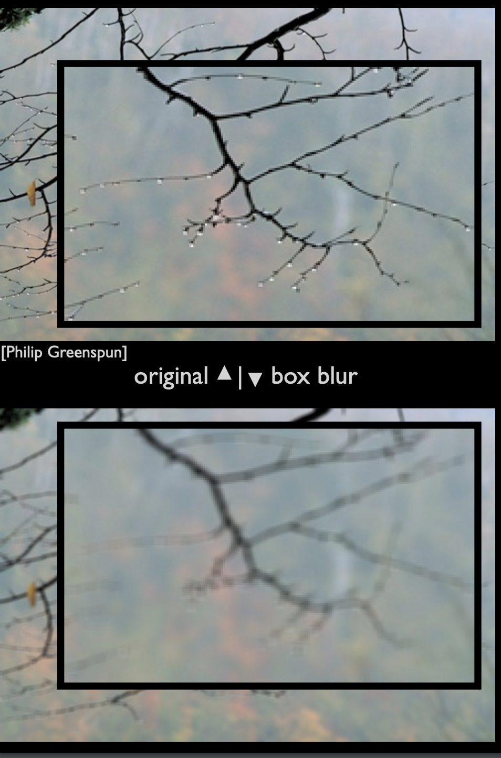
Understanding Convolutions in Image Manipulation
Enhance and transform images
Apply filters/kernels
Modify pixel values
Extract meaningful features
Notes:
Convolutions play a crucial role in image manipulation, allowing us to enhance and transform images in various ways.
They involve applying filters or kernels to images, altering the pixel values and extracting meaningful features.
Talk about what are Convolutions to give the students a refresher?
Convolutions are mathematical operations performed on images using small matrices called filters or kernels.
Each filter consists of weights that determine how neighboring pixels contribute to the output.

Slide 13
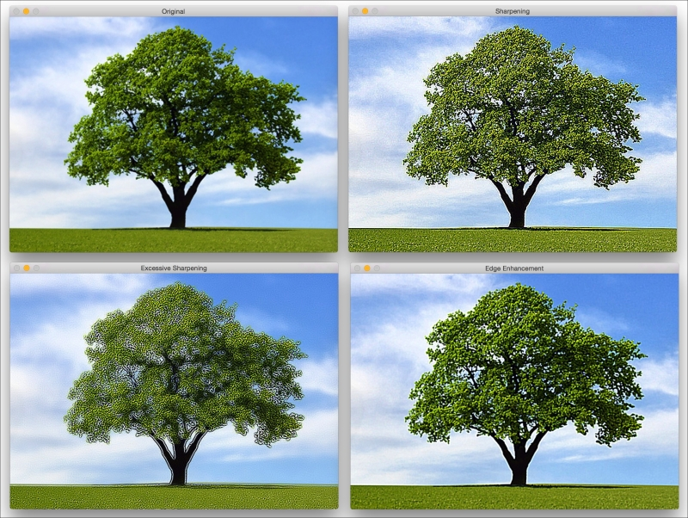
Filtering and Convolution
Image Source: https://aigeekprogrammer.com/convolutional-neural-network-image-recognition-part-2/
Notes:
Talk about what is a convolution and how does it work. Also talk about why does it help.
Draw attention to the fact that this has been covered in one of the previous class “Neural Net Architectures” and give a refresher about what are the advantages.
Show how the filter being used works as shown in the example beside it.

Slide 14
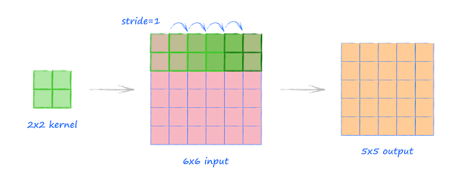
Applying Convolutions
Convolution Parameters:
Stride: Determines the step size when sliding the filter over the image.
Padding: Adds additional pixels around the image to preserve spatial dimensions during convolution.
Size and Shape: Filters can vary in size and shape, allowing customization based on the desired effect.
Image Source: http://makeyourownneuralnetwork.blogspot.com/2020/02/calculating-output-size-of-convolutions.html

Slide 15
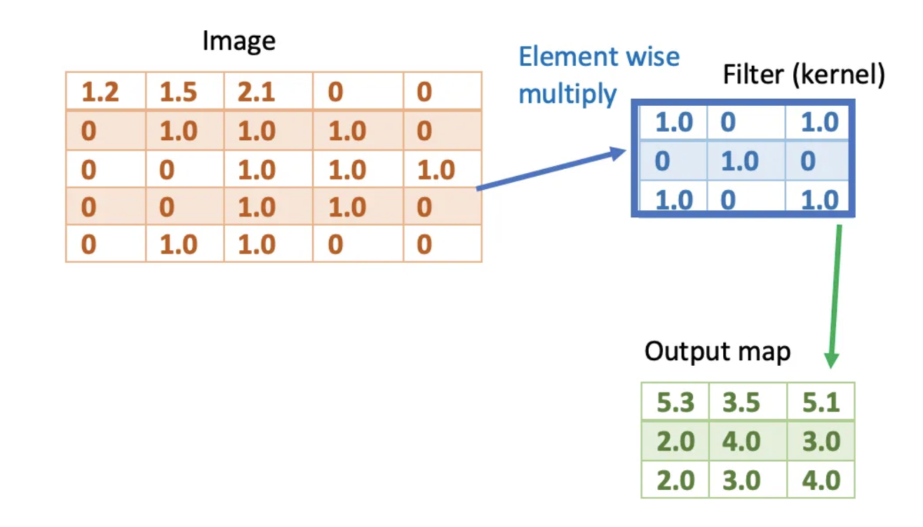
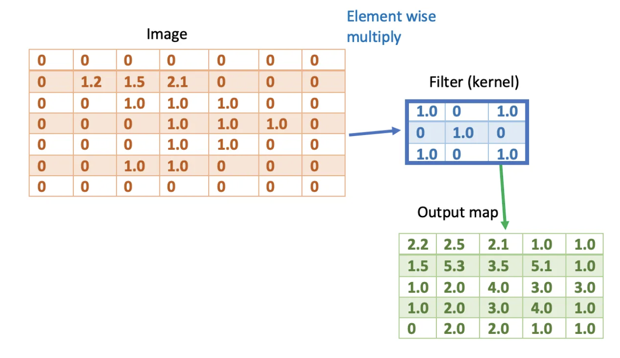
Applying Convolutions
Two main types of padding:
Same padding — Pad so that the output size matches the input size.
Valid padding — Use no padding. Output shrinks

Slide 16
Convolutional Layer
A convolutional layer like any other layer consists of multiple neurons.
Each neuron in the convolutional layer has a set of weights defining its filter (kernel).
This filter is convolved with the input to generate a 2-D activation map.
The dimensions of output for each neuron is [height, width, 1].
If we stack together the output map of all neurons in one convolutional layer, then we will have an output of dimension [height, width, channel]; where channel is the number of neurons in the layer. Channel is the depth of the outcome.

Slide 17
Convolutional Neural Network
A Convolutional Neural Network (CNN) is a neural network that consists of multiple convolutional layers, pooling layers and fully connected layers. It is often to process grid-like topology, such as images.
The convolutional layers apply a convolution operation to the input using a set of learnable filters. They together build feature map hierarchies.
The pooling layers (max pooling or average pooling) down-sample the feature maps to reduce computation.

Slide 18
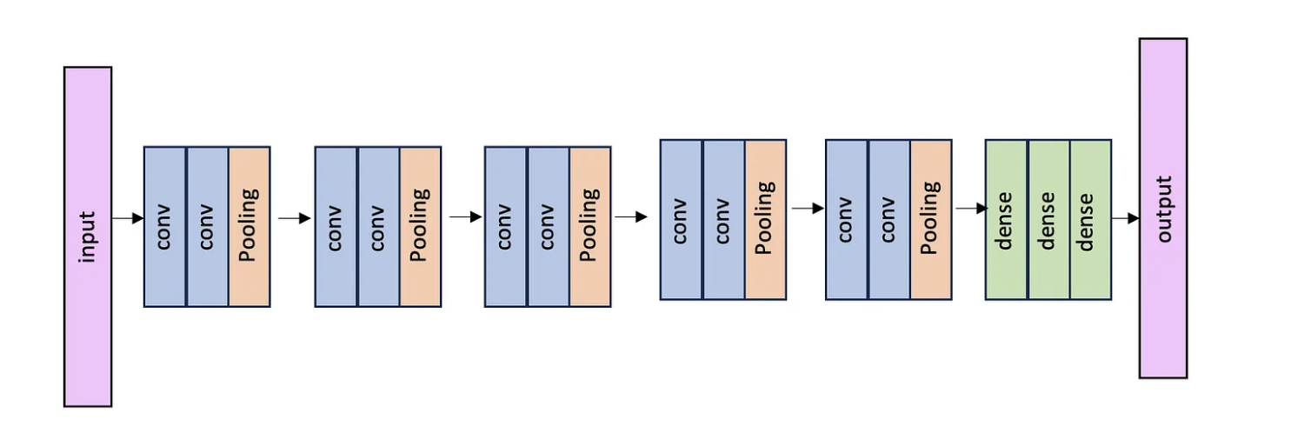
Convolutional Neural Network

Slide 19
CNNs refresher
Feature Maps in CNNs:
Output of convolutional filters detecting patterns like edges or textures
Multiple filters generate diverse feature maps capturing specific aspects of the input.
Subsampling (Pooling) in CNNs:
Reduces spatial dimensions of feature maps (width and height).
Max-pooling retains maximum values, emphasizing prominent features.
Average-pooling calculates averages, providing smoothed representations.
Purposes of Subsampling:
Dimensionality Reduction: Fewer parameters enhance computational efficiency.
Translation Invariance: Makes the network less sensitive to position changes.
Focusing on Relevant Features: Retains essential information, discarding redundant details.

Slide 20
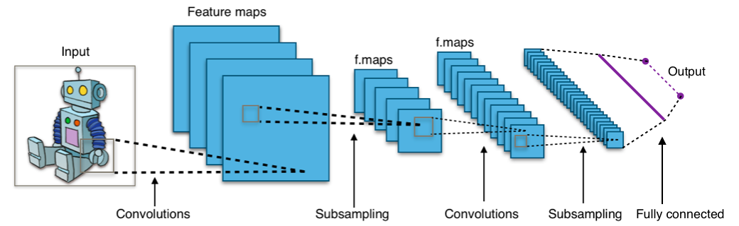
CNNs refresher
Image Source: https://datalya.com/blog/machine-learning/why-convolution-is-useful-in-neural-networks

Slide 21
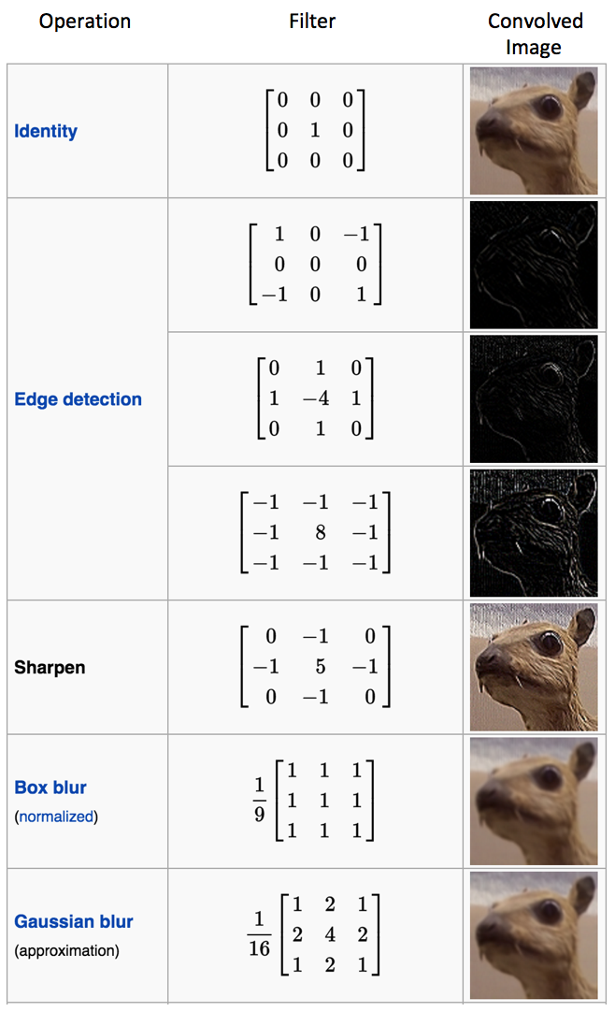
Enhancing Images with Filters
Common Filter Operations:
Edge Detection: Using filters like the Sobel or Roberts operator to identify and highlight edges in images.
Blurring: Applying a Gaussian blur filter to reduce image noise or create a smoother appearance.
Sharpening: Using a sharpening filter to enhance image details and increase perceived clarity.
Image Source: https://ujjwalkarn.me/2016/08/11/intuitive-explanation-convnets/

Slide 22
Image Classification

Slide 23
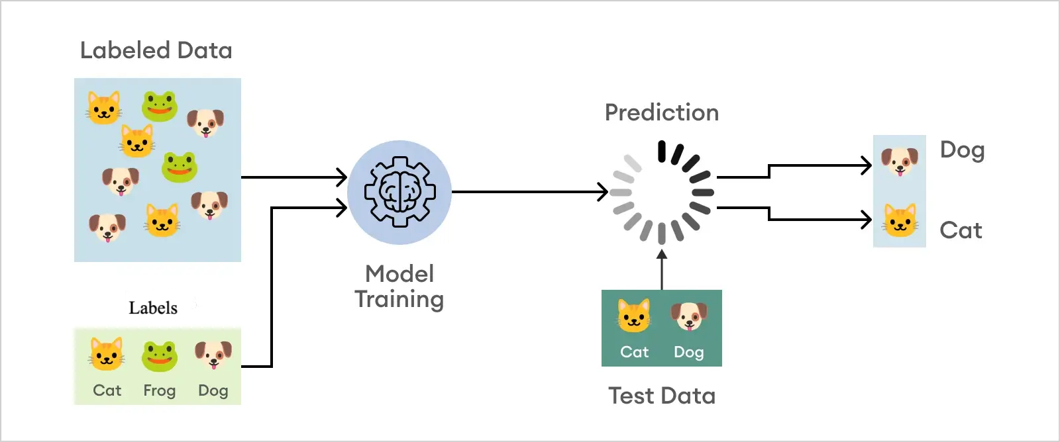
Image Classification
What does it do?
Assigning labels to input images.
Recognizes objects by putting them into predefined categories or classes.
Image Source: https://www.superannotate.com/blog/image-classification-basics

Slide 24
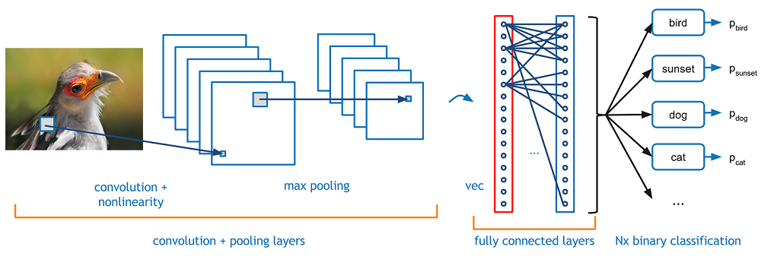
Image Classification using Deep Learning
Feature Extraction:
Convolution, max-pooling, ReLU (non-linear activations)
Extract meaningful features
Prediction:
Softmax function
N-dimensional output (N = classes)
Image Source: https://medium.com/analytics-vidhya/image-classification-techniques-83fd87011cac
https://www.learndatasci.com/tutorials/hands-on-transfer-learning-keras/
Notes:
Expand on the topics for Convolutions, Pooling, ReLU or other non-linear activation functions, Softmax and give a refresher on how they fit together referencing that they covered parts of it in Intro to Neural Nets and Neural Net Architecture (Previous lessons)

Slide 25
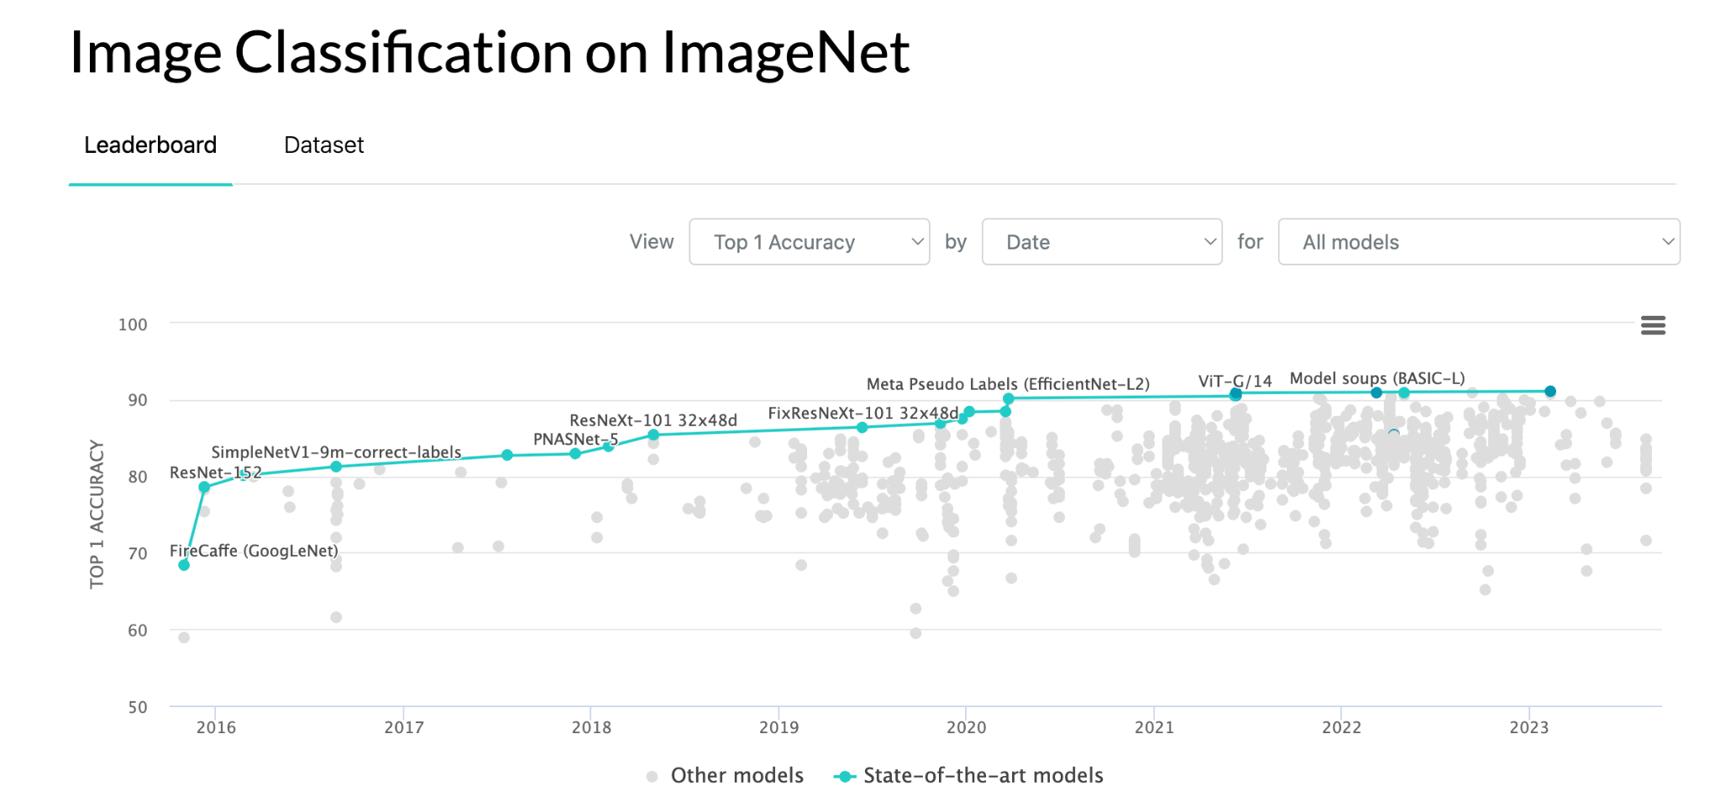
Diverse Architectures for Image Classification
AlexNet (2012):
Popularized deep learning in CV
ILSVRC winner
ZFNet (2013):
Refined AlexNet's architecture
Improved CNN performance
VGGNet (2014):
Simplicity and uniformity
Deep networks with 16 or 19 layers
GoogLeNet (Inception) (2014):
Inception modules with different filters
Enhanced efficiency and performance
Image Source: https://paperswithcode.com/sota/image-classification-on-imagenet

Slide 26
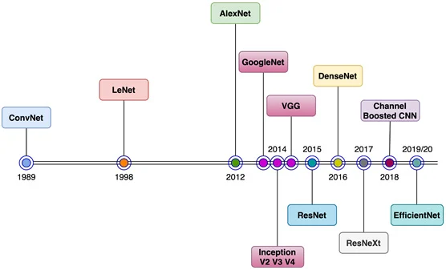
Diverse Architectures for Image Classification
ResNet (2015):
Very deep architectures
Addressed vanishing gradient with skip connections
DenseNet (2016):
Dense connectivity between layers
Feed-forward connections
MobileNet (2017):
Designed for mobile/embedded vision
Efficiency and low computational requirements
EfficientNet (2019):
Efficient scaling across dimensions
Versatile applications, including mobile and edge devices
Image Source: https://wikidocs.net/165403

Slide 27
Diverse Architectures for Image Classification
Vision Transformer (ViT - 2020):
Utilizes a transformer-based architecture for image processing.
MLP-Mixer (2021):
Utilizes a mixer-based architecture with multi-layer perceptrons (MLPs) for image processing.
Swin Transformer (2021):
Features a hierarchical architecture processing images at multiple scales.

Slide 28
VGG

Slide 29
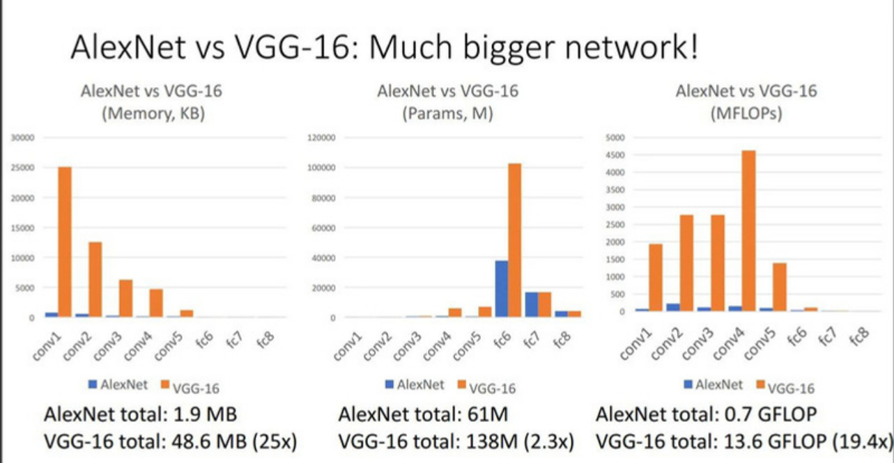
Unveiling VGG
What is VGG?
VGG = Visual Geometry Group
a research group at University of Oxford.
VGG is a deep convolutional neural network for image classification tasks.
Image Source: https://pub.towardsai.net/do-you-know-vgg-16-f7b8f9a5e550

Slide 30
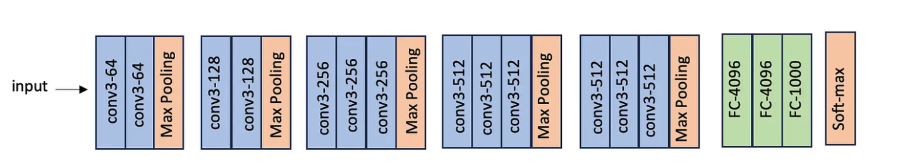
Unveiling VGG
VGG comes in few configurations;
all have the same architecture just the number of layers are different.
The most famous ones are VGG16 and VGG19.
The VGG19 is deeper and has better performance than VGG16.

Slide 31
Unveiling VGG
6 blocks:
First 5 blocks are convolutional + pooling
6-th block is fully connected layers

Slide 32
Unveiling VGG
All convolutional layers use 3x3 filters with a stride=1
All max pooling layers are 2x2 with a stride=2 →
They halve width & height of input feature map
This is called down sampling

Slide 33
Unveiling VGG
convolutional layers start with 64 filters and doubles after every pooling until it reaches 512 filters.
All convolutional layers use “same” padding to maintain the same size between input and output, and they all use RELU activation function.
Notes:
Same padding: Same padding is a padding technique to ensure the output volume of a convolutional operation has the same height and width as the input volume. It works by padding the input with zeros evenly on all sides such that the spatial dimensions are unchanged after the convolution operation.

Slide 34
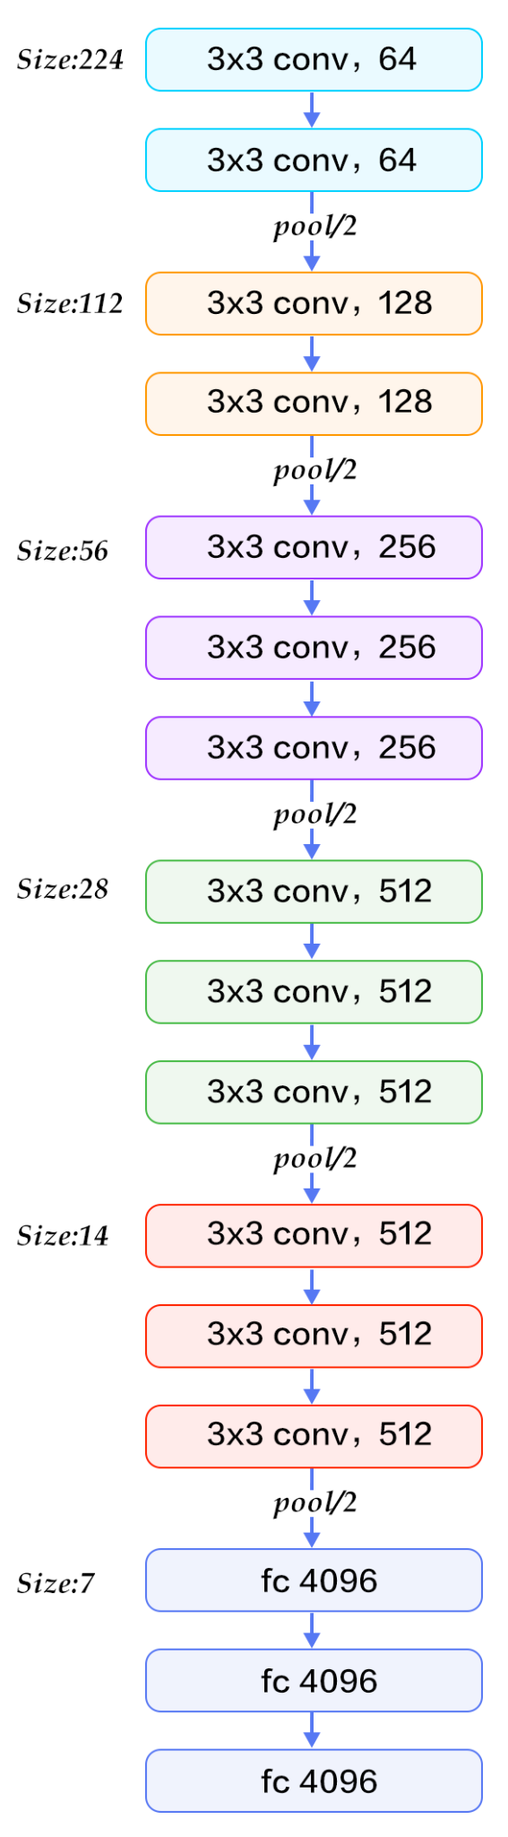
Convolutional Layers
Layer Composition:
16 layers, 13 convolutional layers
Filter Channels:
Block 1: 64 channels
Block 2: 128 channels
Block 3: 256 channels
Block 4: 512 channels
Block 5: 512 channels
Image Source: https://www.kaggle.com/code/blurredmachine/vggnet-16-architecture-a-complete-guide

Slide 35
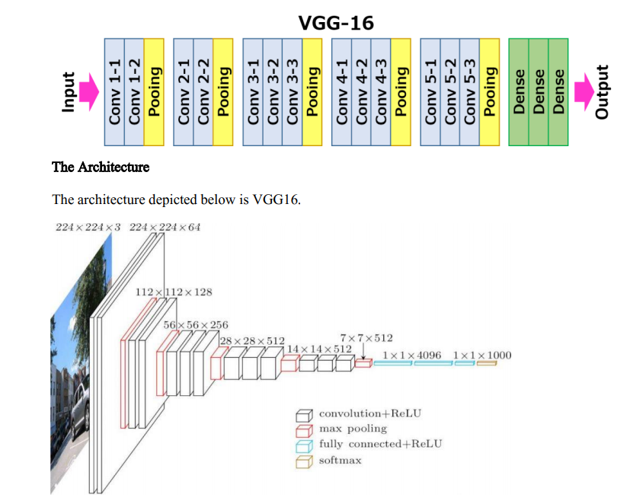
Image Source: https://medium.com/nerd-for-tech/vgg-16-easiest-explanation-12453b599526

Slide 36
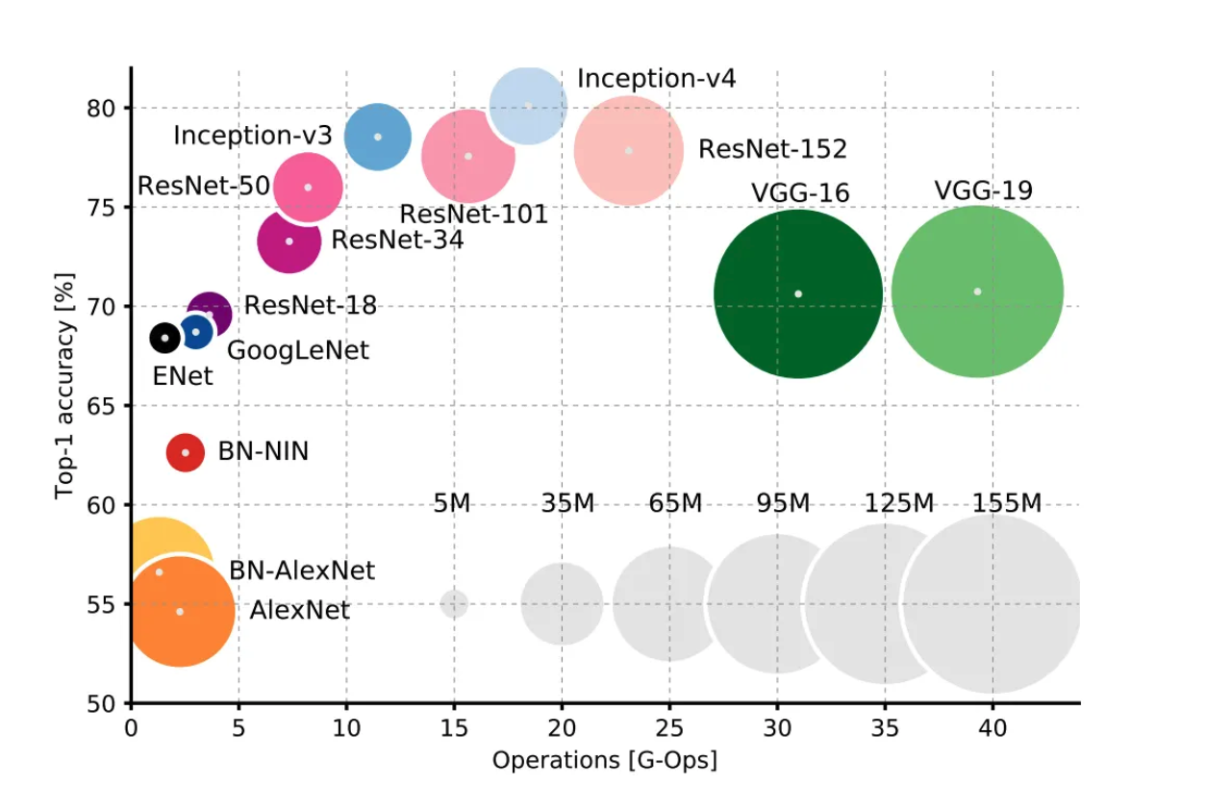
Cost vs Accuracy

Slide 37
ResNet

Slide 38

What is a ResNet?
Short for Residual Network, introduced in 2015 by Microsoft Research in their paper titled "Deep Residual Learning for Image Recognition" in 2015.
ResNets, introduces concept of Residual and skip connections.
Image Source: https://huggingface.co/spaces/pytorch/ResNet

Slide 39
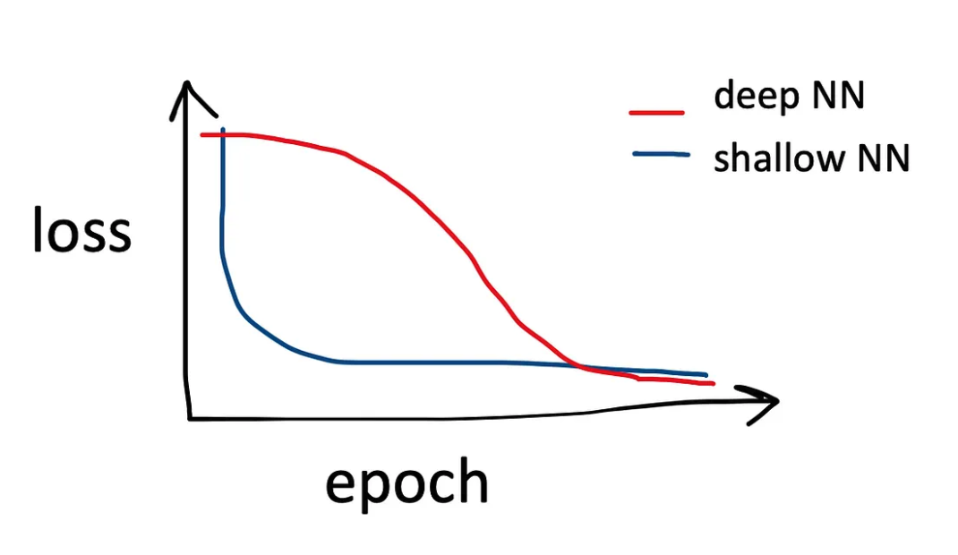
Why ResNet?
when we train shallow neural networks, the training loss starts decreasing in early epochs.
But in deep neural networks the training loss decreases very minimal in early epochs, and after first few epochs it suddenly drops.
This is a big obstacle in practical training in deep neural networks.

Slide 40
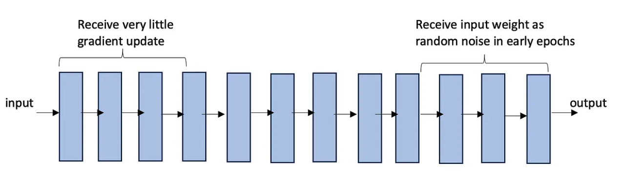
Why ResNet?
In early layers of a deep NN, vanishing gradient descent problem kicks in; i.e. the gradient of the loss vanishes by the time it reaches early layers of the networks and so the parameters of these layers receive very little update.
In late layers of a deep NN, very little of the original signal arrives.

Slide 41
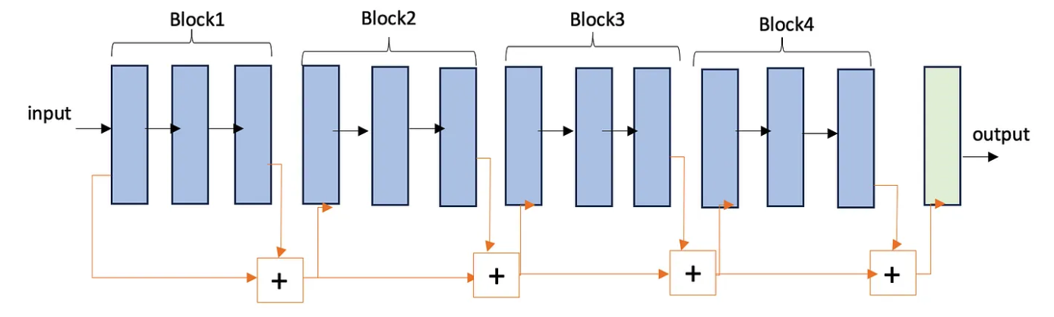
Skip Connection
The idea of skip connection, is to group layers of the network into blocks, and for each block make the input to both go through and around the block.

Slide 42
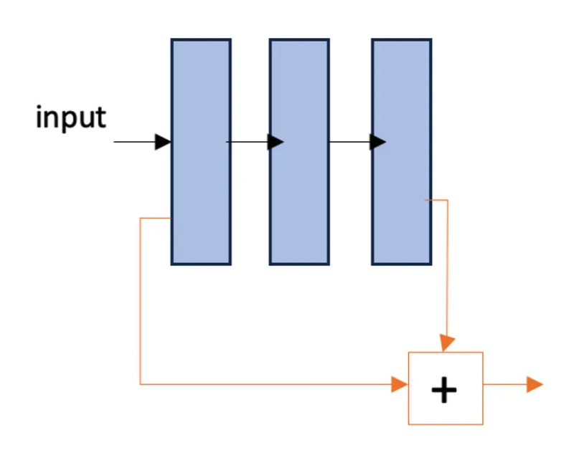
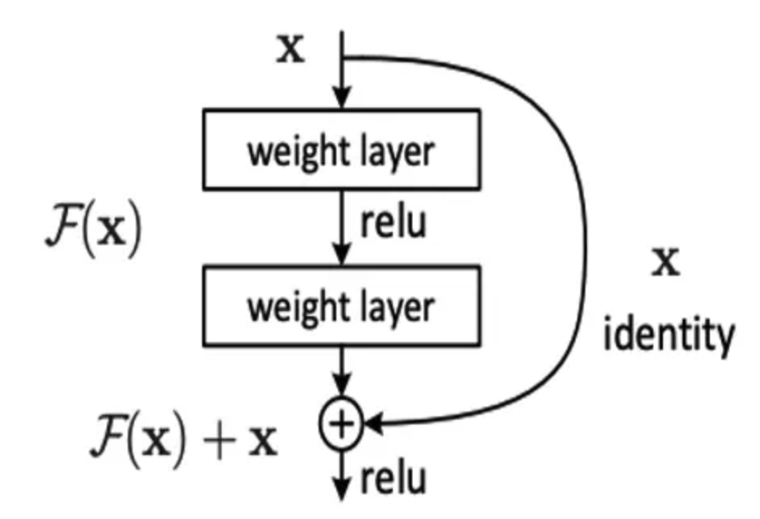
A Residual Block
The “+” sign means combining. It is often implemented as element-wise addition.

Slide 43
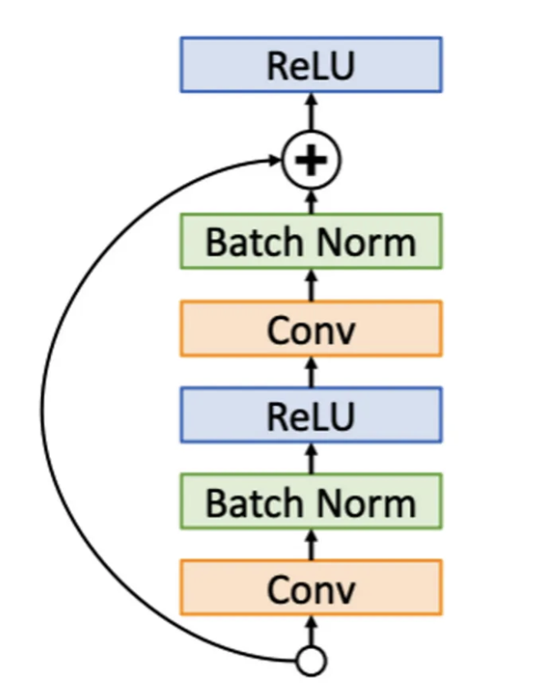
A Residual Block
Each residual block consists of a convolutional layer, batch normalization and and RELU activation functions.

Slide 44
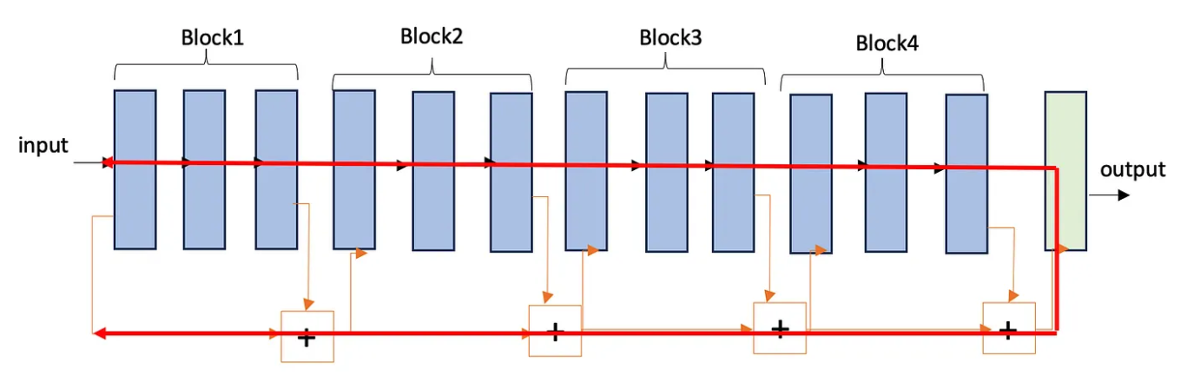
ResNet
ResNet is built by stacking multiple residual blocks.
Original ResNet has various architectures from 18 layers to 152 layers.

Slide 45
ResNet
A network made of residual blocks is called a residual networks or ResNet.
They have couple advantages that make them faster and easier to train.
The network has shorter gradient paths.

Slide 46
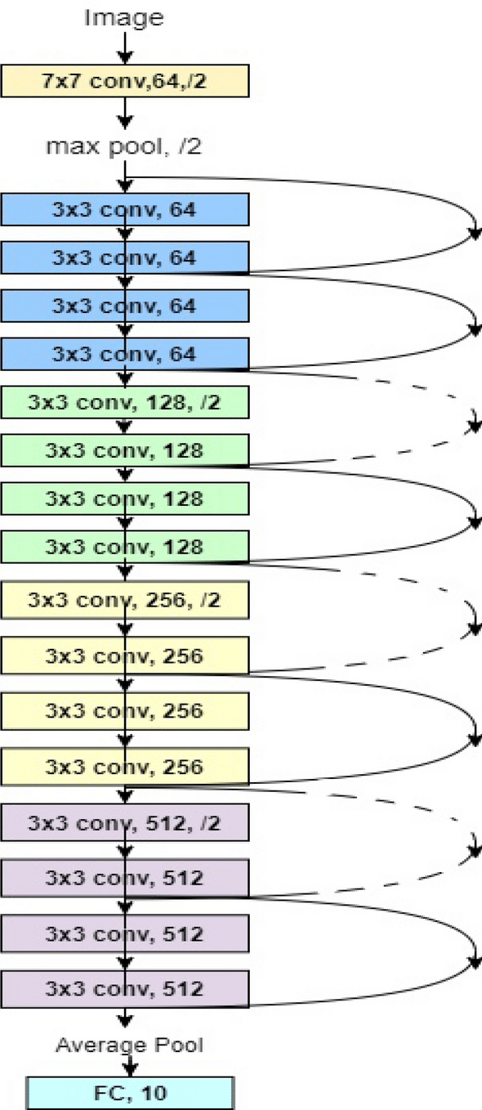
ResNet-18 Convolutional Layers
Layer Composition:
8 residual layers
4 blocks
Each block : 4 convolutional layers with 3x3 filters
Each stage halves the resolution(stride-2) and doubles the channels.
Filter Channels:
Block 1: 64 channels
Block 2: 128 channels
Block 3: 256 channels
Block 4: 512 channels
Intuition:
Element-wise multiplications and additions between input pixels and filter values.
Capture localized patterns in the data.
Number of Filters: Determines the number of unique features extracted.

Slide 47
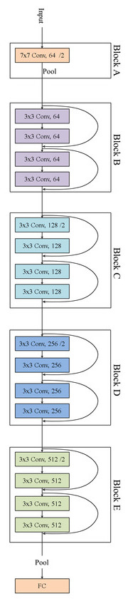
Residual Blocks
Block 1:
2 residual layers with 64 channels each
1x1 and 3x3 convolutions
Identity shortcut connection
Block 2:
2 residual layers with 128 channels each
1x1 and 3x3 convolutions
Identity shortcut connection
Block 3:
2 residual layers with 256 channels each
1x1 and 3x3 convolutions
Identity shortcut connection
Block 4:
2 residual layers with 512 channels each
1x1 and 3x3 convolutions
Identity shortcut connection
Image Source: https://www.researchgate.net/figure/ResNet-with-18-layers-depicted-in-five-blocks_fig4_333787753

Slide 48
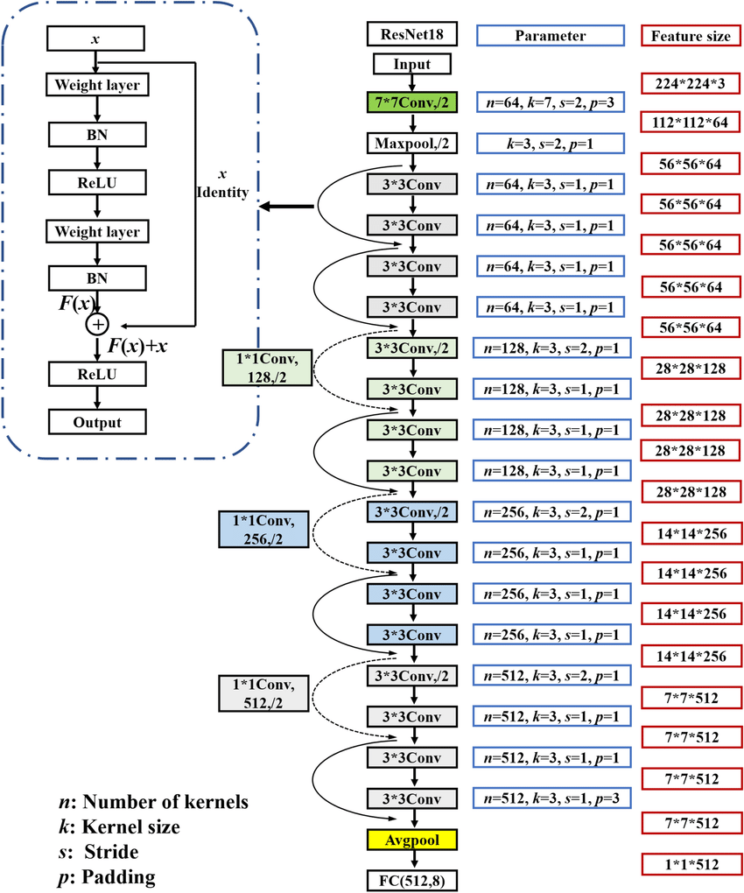
Tying it all together
Root: 1 conv layer
Stage 1: (C = 64), 2 residual block = 4 conv
Stage 2: ( C = 128), 2 residual block = 4 conv
Stage 3: (C = 256), 2 residual block = 4 conv
Stage 4: (C = 512), 2 residual block = 4 conv
Linear
Notes:
Talk through shapes with whiteboard

Slide 49
Summary
Convolution operation
Pooling layer
VGG Network
ResNet
Notes:
Talk through shapes with whiteboard

